Slide 1
COMP 2120 Object Oriented Programming Using Java
Muhammad Asaduzzaman
School of Computer Science
University of Windsor
Inter/Summer, 2025
Notes:
Find out if you are in the wrong classroom.
Who is from School of Computer Science,
Have you ever taken programming courses.
How many of you have heard about OOP?

Slide 2
About You

Slide 3
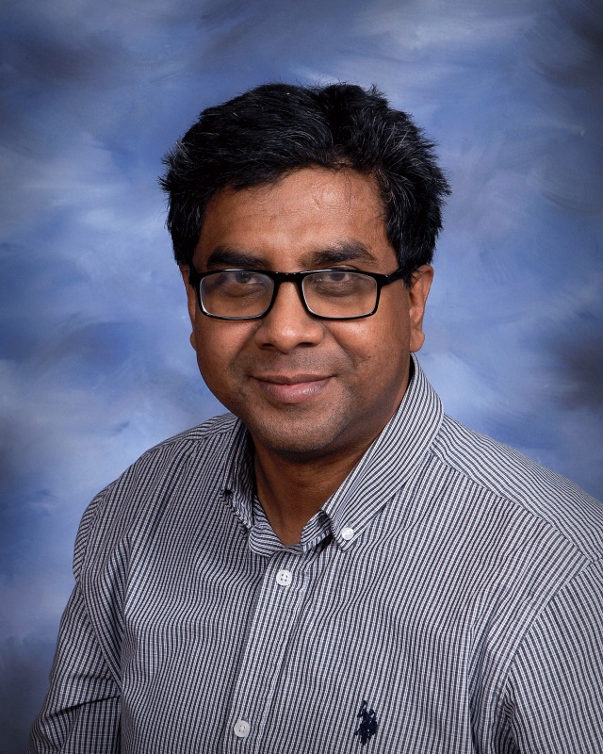
About Me
Assistant Professor
School of Computer Science
masaduzz@uwindsor.ca
https://muhammad-asaduzzaman.github.io/
Office Location Lambton Tower (LT. 8114)
455 Sunset Ave
Windsor, ON N9B 3P4
Research Interests:
Software Maintenance and Evolution, Mining Software Repositories, Program Comprehension, and Recommendation Systems in Software Engineering

Slide 4


About Our TAs
Mehedi | Shanto | shanto1@windsor.ca | PHD
Jenish | Modi | modi8a@uwindsor.ca | MSC

Slide 5
How to Reach Us?
Send email to masaduzz@uwindsor.ca
Please put [COMP 2120] in the subject of the email so that I can read your emails in a very organized way. Office Hours: Monday 10:00 AM – 12:00 PM
You can also contact individual TAs using the email addresses listed in the previous page.

Slide 6


How to help us?
Please help us to create a better learning environment:
Keep your phone silent
Don’t use your phones during the lectures
No social media, instant messages, or games
Use your common sense
Ask me if you are not sure ☺ I am here to help you!

Slide 7
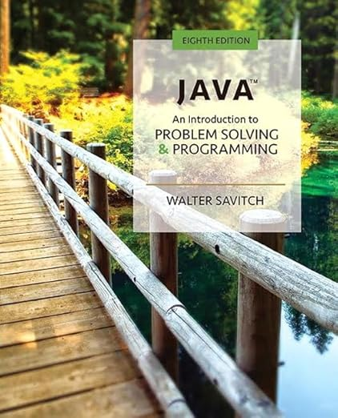
Course Textbook
Java: An Introduction to Problem Solving and Programming (8e) by Walter Savitch

Slide 8
Course Timetable
Monday & Wednesday, 8:30 AM – 9:50 PM
(Erie Hall 1118)

Slide 9
Course Timetable
Lab Sections | Time | Location
Section 51 | Monday (1:00 PM-2:20 PM) | Erie Hall 3119
Section 52 | Monday (4:00 PM-5:20 PM) | Erie Hall 3119

Slide 10
Course Evaluation
Category | Marks | Description
Class Participation | 10% | End of class quiz
Assignment | 12% | 3 Assignments
Labs | 16% | 8 Lab Activities
Midterm Exam | 22% | Wednesday, June 25
Final Exam | 40% | TBA

Slide 11

How to be successful in this course?
Attend lectures
Attend and practice in lab sessions
Finish assignments
Practice at home
Read resources (textbook and recommended resources)
Practice, again

Slide 12
Topics We Plan to Cover (Tentative)
Introduction to Java
Basic Computation
Control Flow
Classes and Methods
Objects and Methods
Arrays
Inheritance, Polymorphism and Interfaces
Exception Handling
Recursion
Generics
Input/Output
Window Interfaces Using Swing (Time Permitted)
(The instructor reserves the right to change the outline to accommodate student pace and understanding of the subject matter.)

Slide 13
Course Learning Outcomes
At the end of the course, the successful student will know and be able to:
Write, compile, execute and debug Java programs

Slide 14
Course Learning Outcomes
At the end of the course, the successful student will know and be able to:
Write, compile, execute and debug Java programs
Understand object-oriented programming principles

Slide 15
Course Learning Outcomes
At the end of the course, the successful student will know and be able to:
Write, compile, execute and debug Java programs
Understand object-oriented programming principles
Write code to solve real-world problems using objects

Slide 16
Course Learning Outcomes
At the end of the course, the successful student will know and be able to:
Write, compile, execute and debug Java programs
Understand object-oriented programming principles
Write code to solve real-world problems using objects
Explain and use exception handling mechanism in Java programs

Slide 17
Course Learning Outcomes
At the end of the course, the successful student will know and be able to:
Write, compile, execute and debug Java programs
Understand object-oriented programming principles
Write code to solve real-world problems using objects
Explain and use exception handling mechanism in Java programs
Understand and use graphical user interfaces using Java libraries

Slide 18
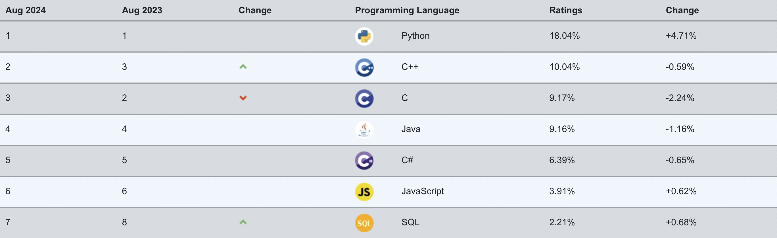
Why Java?
Pure OOP
Statically typed programming language
A popular programming language
Platform independent: "write once, run anywhere" (WORA)
Syntax of expressions and assignments are similar to that of other high-level languages
Notes:
https://www.tiobe.com/tiobe-index/

Slide 19
Procedural Programming
Struct account {
char * owner;
int accountId;
float balance;
float interestRate;
char accountType;
};
Procedure 1: Deposit() {...}
Data Structure:
Bank Account
Procedure 2: Withdraw() {...}
Procedure 3: Transfer() {...}
Notes:
Procedures are often hard to reuse.
Think about if you need to handle cash accounts, check accounts, fix-rate cash accounts, variable-rate check accounts, etc.

Slide 20
Object oriented programming
Programs are organized using classes and objects (e.g., a person, a product, an account)
Classes have both data and methods
You can reuse by extending existing classes
public class BankAccount {
private String owner;
private int accountId;
private double balance;
private double interestRate;
public void deposit (double amount) {...}
public double withdrawAll () {...}
private double computeInterest (double amount) {...}
};
Notes:
Think about how to effectively implement and maintain a cash account or a check account?
Think about how if some information should not be visible to other classes or objects?

Slide 21
See you on Wednesday!
(No lab sessions this week or next week ☺)

